Slide 1

SALARY PREDICTION OF DATA PROFESSIONS
DATA SCIENCE

Slide 2

CONTENT
PROJECT OVERVIEW
DATA DESCRIPTION
CODES & PREDICTION
PIPELINE
WEB API

Slide 3
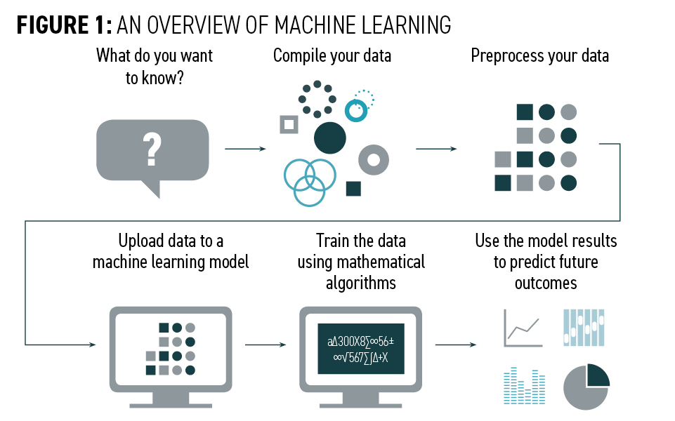
PROJECT OVERVIEW
1. OBJECTIVE: Predict salaries of data professionals using regression techniques.
2. APPROCH: Employ data analysis, feature engineering, and model development.
3. DATASET: Utilize a comprehensive dataset capturing relevant attributes.
4. METHODOLOGY: Explore various regression algorithms for accurate predictions.
5.OUTCOME : Gain practical ML skills through hands-on experience in salary prediction.

Slide 4
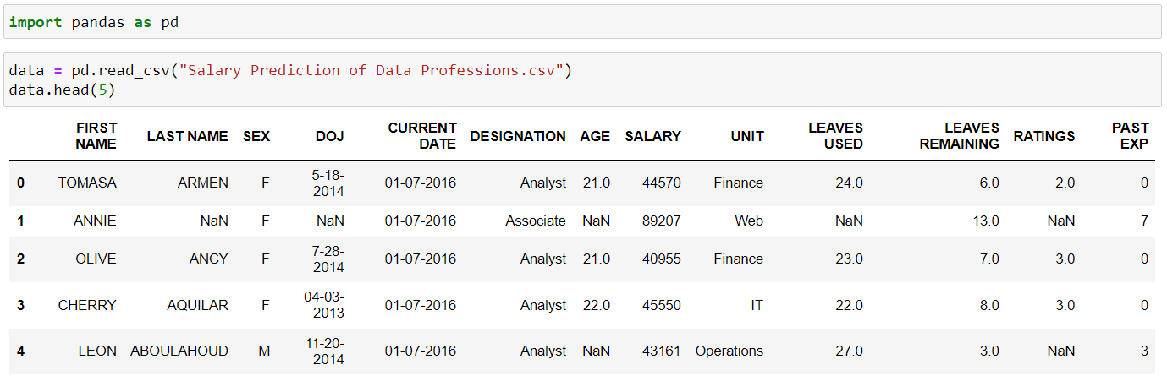
DATA DESCRIPTION
“Salary Prediction Of Data Professions”
FIRST NAME
LAST NAME
SEX
DOJ
CURRENT DATE
DESIGNATION
AGE
SALARY
UNIT
LEAVES USED
LEAVES REMAINING
RATINGS
PAST EXP

Slide 5


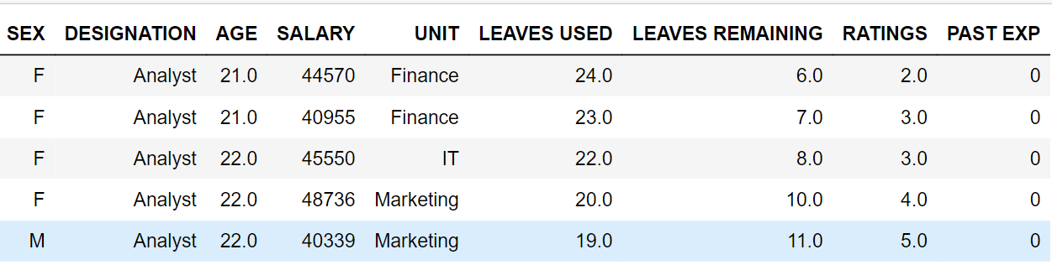
CODES & PREDICTION
PREPROCESSING CODES
CODE:- To Remove any unnecessary columns from the table.
CODE:- To Remove the values that are nan in the table.

Slide 6
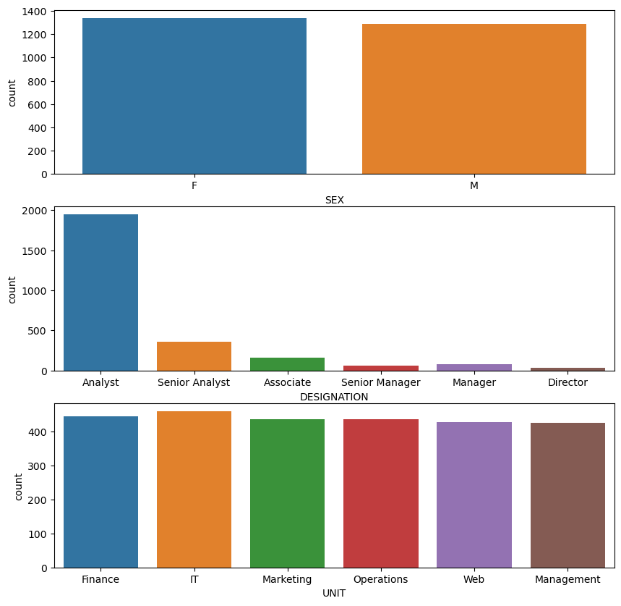
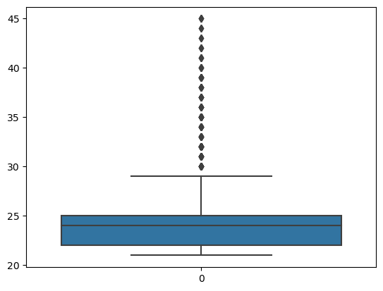
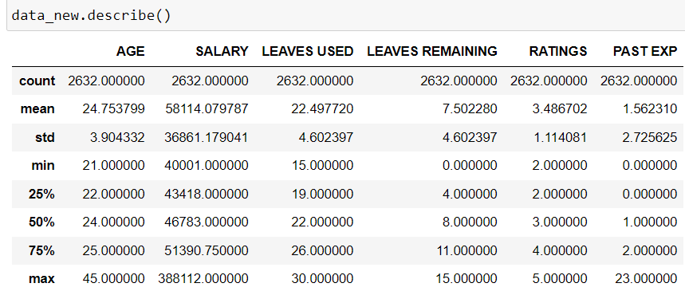
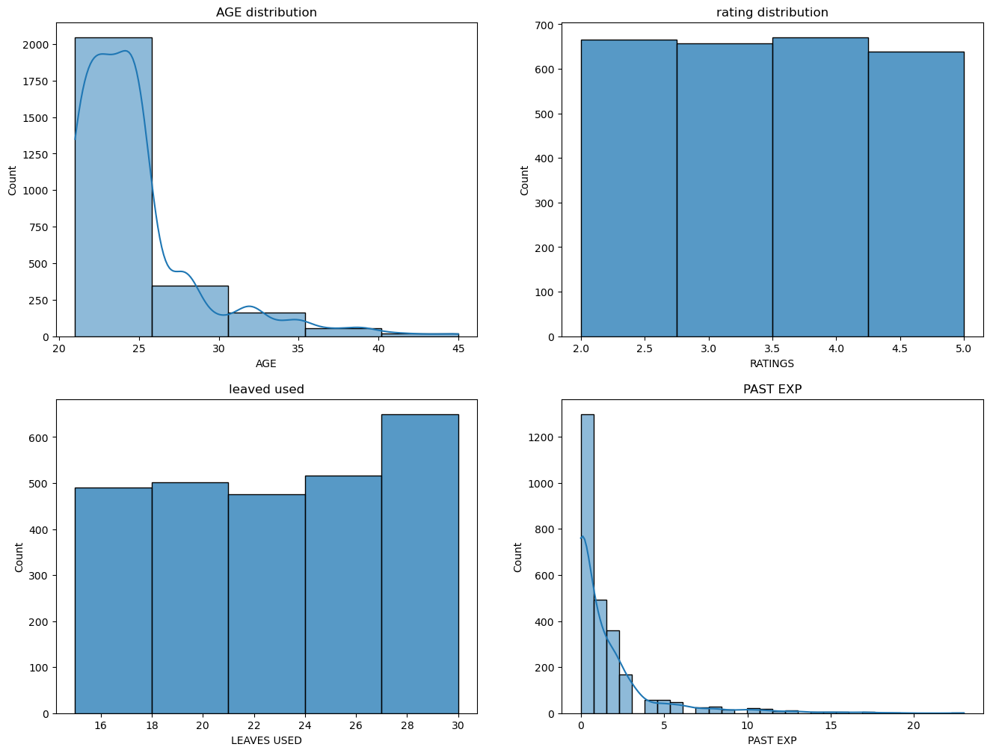
EXPLORATRY DATA ANALYSIS (EDA) CODES
VISUALIZATION:-A box plot for the age column to identify outliers, a count plot for categorical variables in the table like sex, designation, and unit, and a histogram plot for continuous variables like age, ratings, leaves used, and past experience .
STATISTICS DESCRIBE

Slide 7
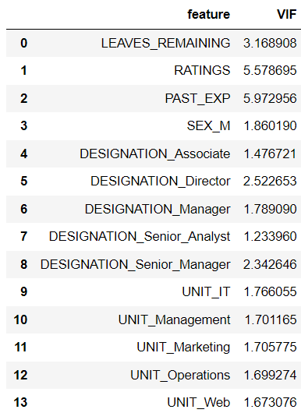
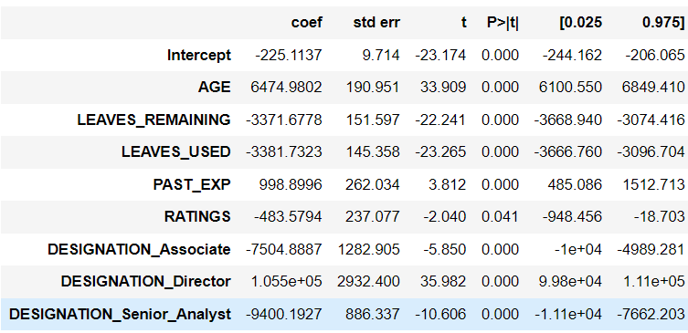
ENCODING & FEATURE ENGINEERING
CODE:- Decoding the Categorical variables in the table.
Significant variables that are present in the table.

Slide 8

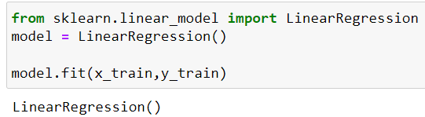


LINEAR REGRESSION MODEL
STEPS TO PERFORM LINEAR REGRESSION
1) Splitting the data into independent variable (x) and target variable (y).
2) Split the dataset into training and testing sets to evaluate the model's performance.
3) Create an instance of the linear regression model.
4) Train the model using the training data.
5) model.predict(X_test)
6) Assess the model's performance using evaluation metrics such as R SQUARED(r2).
7) Also performed Cross validation and the model is generalized.
OUTPUT:-
OUTPUT:-

Slide 9

DECISION TREE MODEL
STEPS TO PERFORM DECISION TREE MODEL
1) Preprocess the data, handling missing values, encoding categorical variables, and splitting it into features (x) and target variable (y).
2) Split the dataset into training and testing sets to evaluate the model's performance.
3) Create an instance of the decision tree regression model.
4) Using GridSearchCV , we will get the best parameters for the model.
5) Train the model using the training data and the best parameters.
6) Use the trained model to make predictions on the test set.
7) Assess the model's performance using evaluation metrics such as Root Squared (r2).

Slide 10
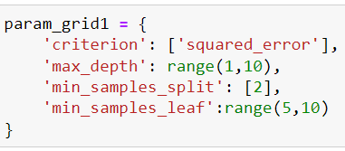
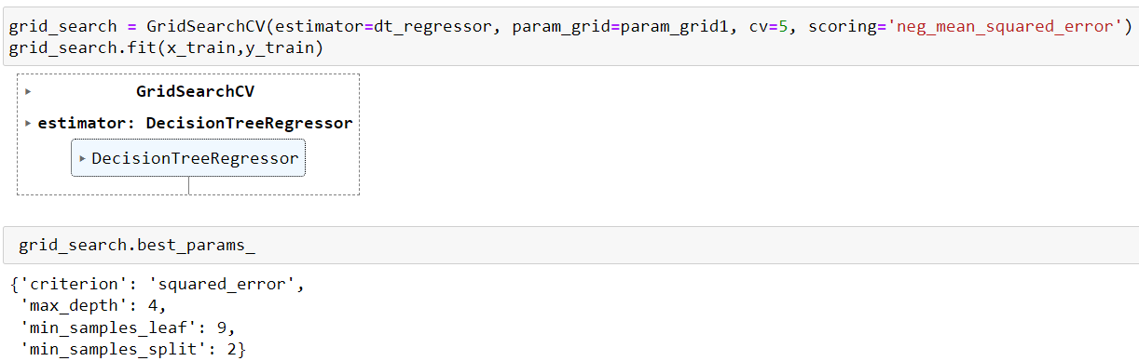
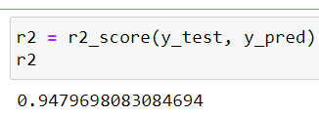
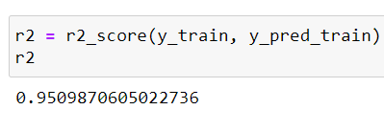
DECISION TREE MODEL(codes)
OUTPUT:-
OUTPUT:-

Slide 11

RANDOM FOREST MODEL
STEPS TO PERFORM RANDOM FOREST MODEL
1) Preprocess the data, handling missing values, encoding categorical variables, and splitting it into features (x) and target variable (y).
2) Split the dataset into training and testing sets to evaluate the model's performance.
3) Create an instance of the Random Forest regression model.
Using GridSearchCV , we will get the best parameters for the model.
We can also do feature importance in random forest model ,using this we will get the best result for the model.
Train the model using the training data and the best parameters.
5) Use the trained model to make predictions on the test set.
6) Assess the model's performance using evaluation metrics such as Root Squared (r2).

Slide 12

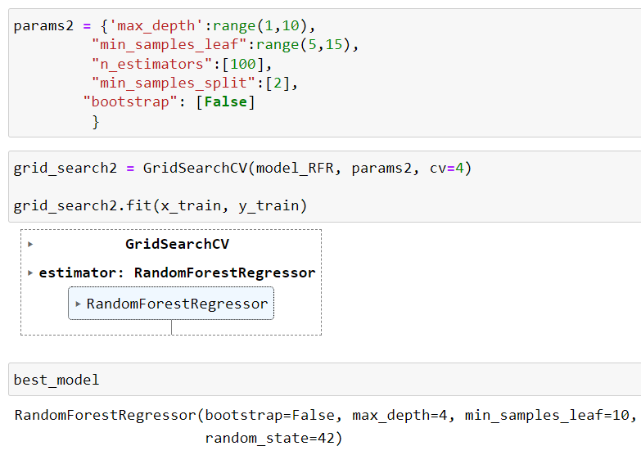
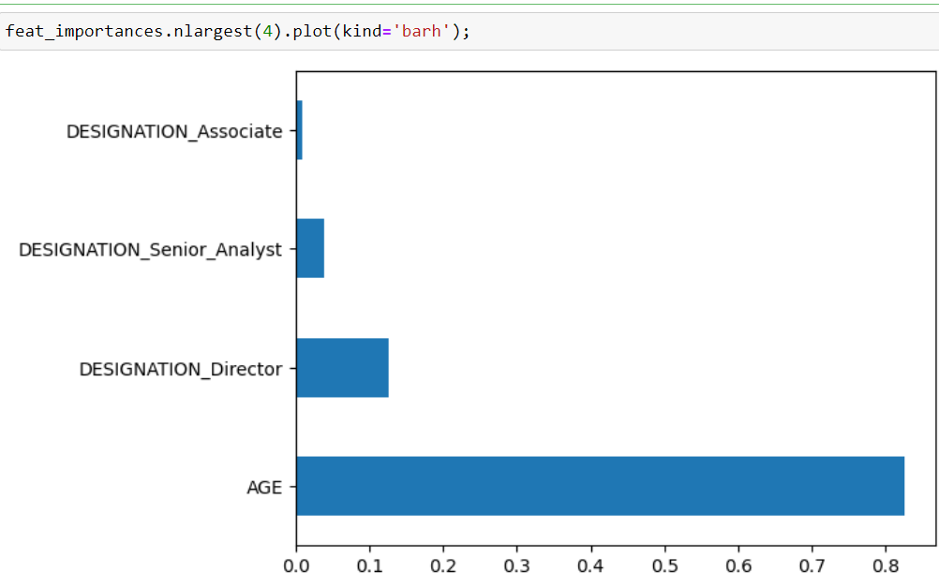
RANDOM FOREST MODEL(codes)
FEATURE IMPORTANCE:-

Slide 13
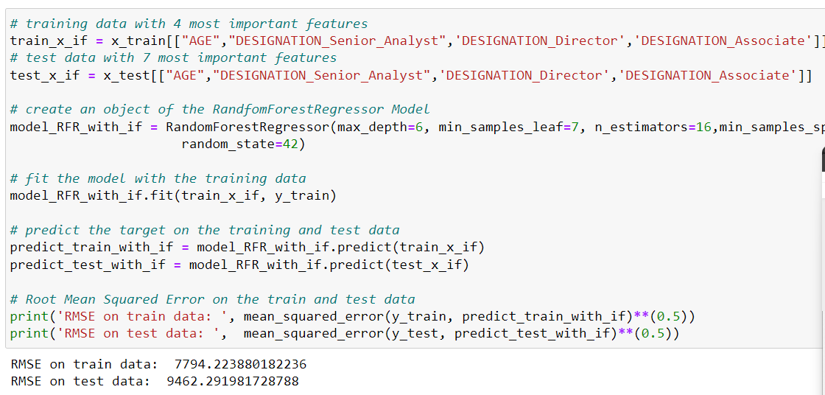
MODEL AFTER FEATURE IMPORTANCE
OUTPUT:-

Slide 14

GRADIENT BOOSTING MODEL
STEPS TO PERFORM GRADIENT BOOSTING MODEL
1) Preprocess the data, handling missing values, encoding categorical variables, and splitting it into features (x) and target variable (y).
2) Split the dataset into training and testing sets to evaluate the model's performance.
3) Create an instance of the Gradient boosting model.
Using GridSearchCV , we will get the best parameters for the model.
We can also do feature importance in random forest model ,using this we will get the best result for the model.
Train the model using the training data and the best paramters.
5) Use the trained model to make predictions on the test set.
6) Assess the model's performance using evaluation metrics such as Root Squared (r2).

Slide 15

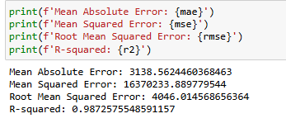
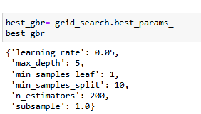
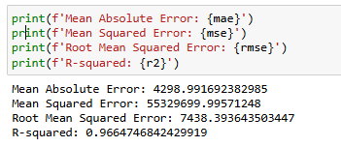
GRADIENT BOOSTING MODEL(codes)
OUTPUT:-
OUTPUT:-

Slide 16

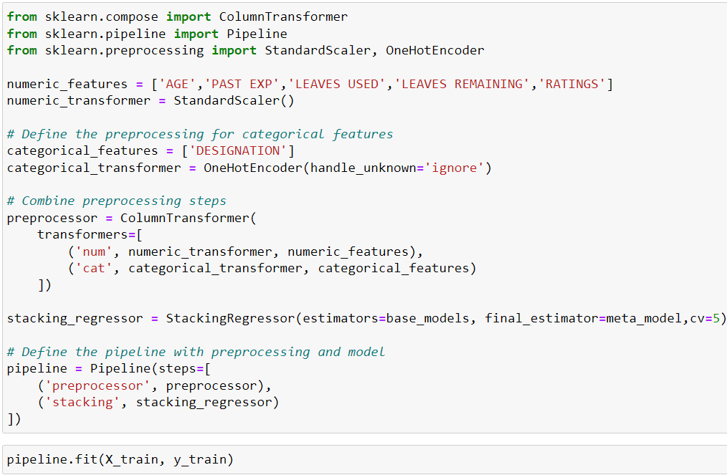
PIPELINE
"In our pipeline design, we employ a stacking regression to combine the strengths of multiple models. The base models include decision trees, random forests, and gradient boosting machines. However, our experiments reveal that linear regression emerges as the best-performing model, leveraging its simplicity and interpretability. The stacking regression then aggregates the predictions from these base models, with linear regression as the meta-model, to produce the final output. This hybrid approach yields improved accuracy and robustness in our regression task."

Slide 17
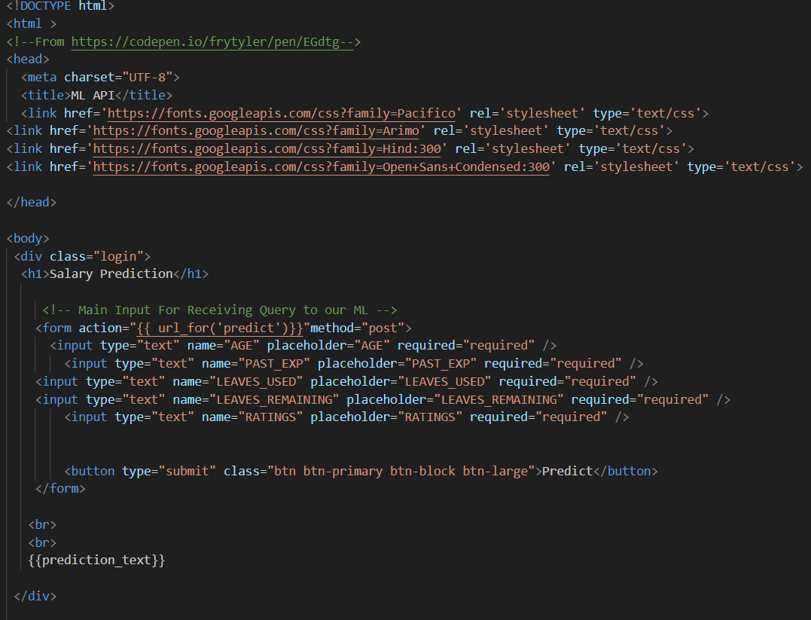
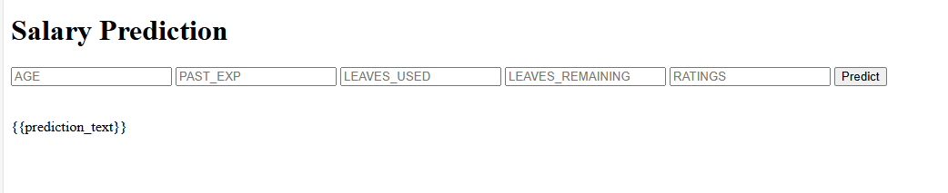
Web app

Slide 18


